Slide 1

DetactaX AI
DEPI Round 3 Graduation Project

Slide 2

Project team:
Zyad Gamal (team leader): Azure Integration & API Deployment.
Basel Mohamed Mostafa: Classification Model structure & Training, Mlflow, and Project Documentation.
Omar Yasser: Project Models Interface GUI using Streamlit.
Mohamed Elfouly: Object Recognition Model.
Zyad Ahmed: Dataset Acquistion & Augmentations.
Abdulrahman: Classification Model Transfer Learning.

Slide 3
Introduction:
Existing tools are complex or slow and require technical expertise.
Users need:
1. Easy-to-use interface
2. Quick predictions
3. High accuracy
4. No technical setup required
- Project Idea: Making a website with both Image Classification & Object Recognition capabilities for multi-use cases.
- Goal: Quickly and accurately classify the main object in an image & recognize multiple objects using top of the line models.

Slide 4
Classification Model Structure

Slide 5

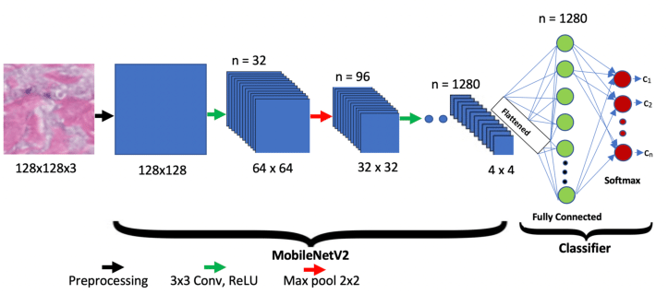
Why MobileNetV2? Key Architectural Advantages: 1. Inverted Residuals: connects the input and output bottleneck layers (thin layers) via a skip connection. Unlike traditional ResNet blocks. 2. Linear Bottlenecks: Linear Activation instead of using ReLU. 3. Efficiency: Using MobileNet’s signature Depthwise Seperable Convolution which offers reduction in parameter counts.
11/28/2025

Slide 6
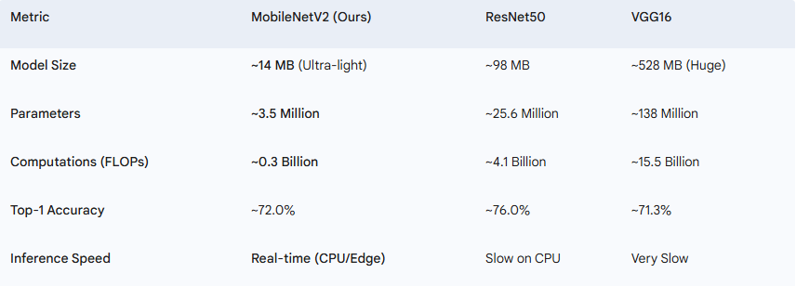
Performance Comparison:

Slide 7
Model Specifications:
Model Based on MobileNetV2.
Retrained using Transfer Learning (Unfroze the last 50 layers).
Dataset Used: CIFAR10.
Augmentations Applied on the Dataset:
Resizing to 224x224.
Random Flip Horizontal and Vertical.
Random Brightness.
Random Contrast.
Random Rotation.
Random Zoom.
Rescaling (1/255).

Slide 8
Model Specifications:
Training Cycle:
20 Epochs training cycle with Validation stages in-between.
Final Model Results:
Accuracy: 0.8451, Loss: 0.4446, Val Accuracy: 0.8404.

Slide 9
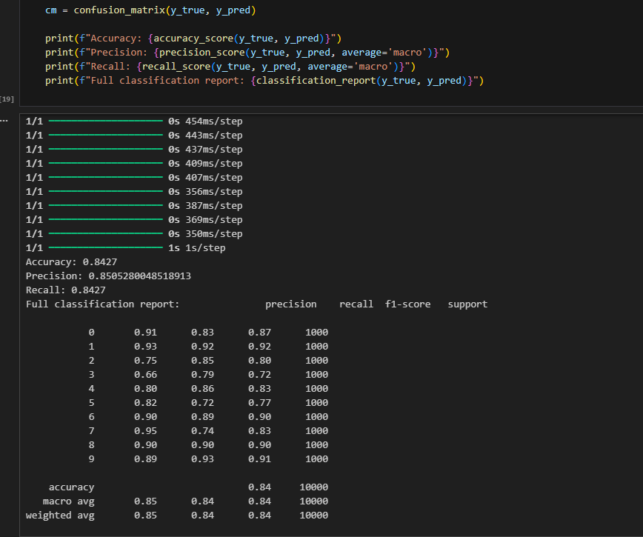
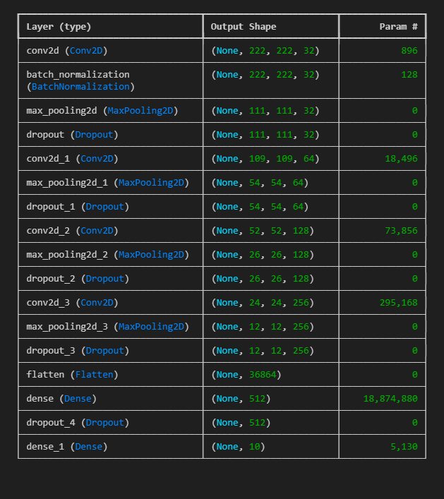
Model Training
11/28/2025

Slide 10
Mlflow

Slide 11
Key Mlflow Components:
MLflow: Central experiment tracker.
Local SQLite: Development tracking database.
Custom Monitors: Production performance tracking and metrics documenting.
Azure Integration: Cloud deployment bridge for easy model redeployment to Azure.

Slide 12
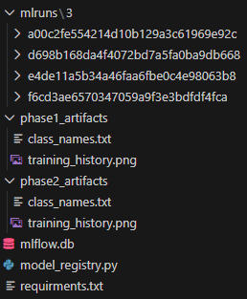
Results & Metrics:
Classification Model Performance
1. Final Test Accuracy: 82%
2. Training Time: ~60 minutes (with MLflow tracking)
3. Model Versions: 3+ registered versions
4. Experiments Tracked: 10+ complete runs
Monitoring System
1. Prediction Tracking: Real-time with <100ms overhead
2. Data Collected: Parameters, metrics, artifacts, predictions
11/28/2025

Slide 13
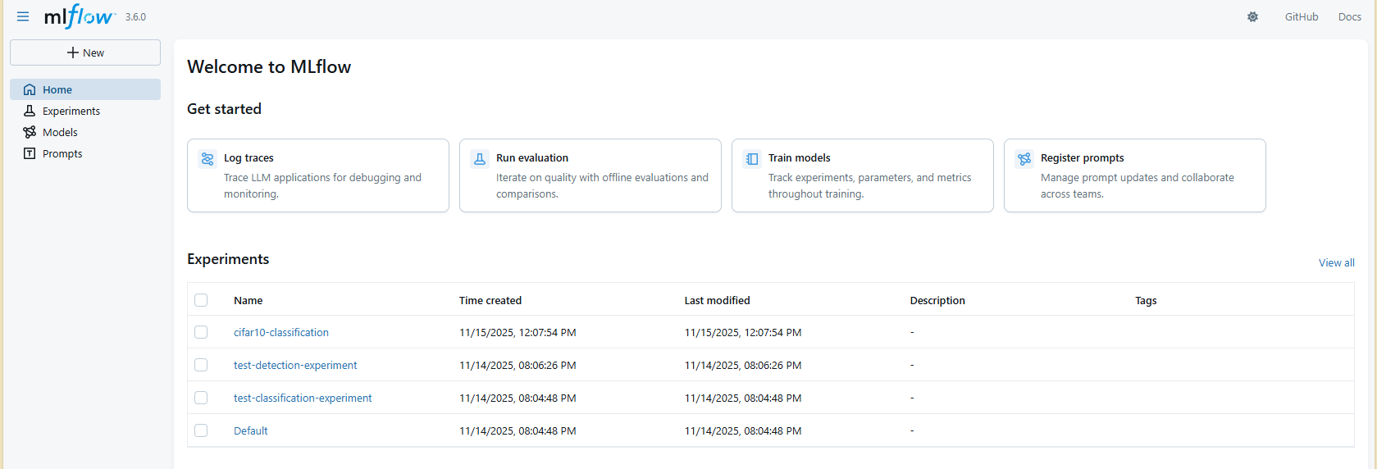

Slide 14
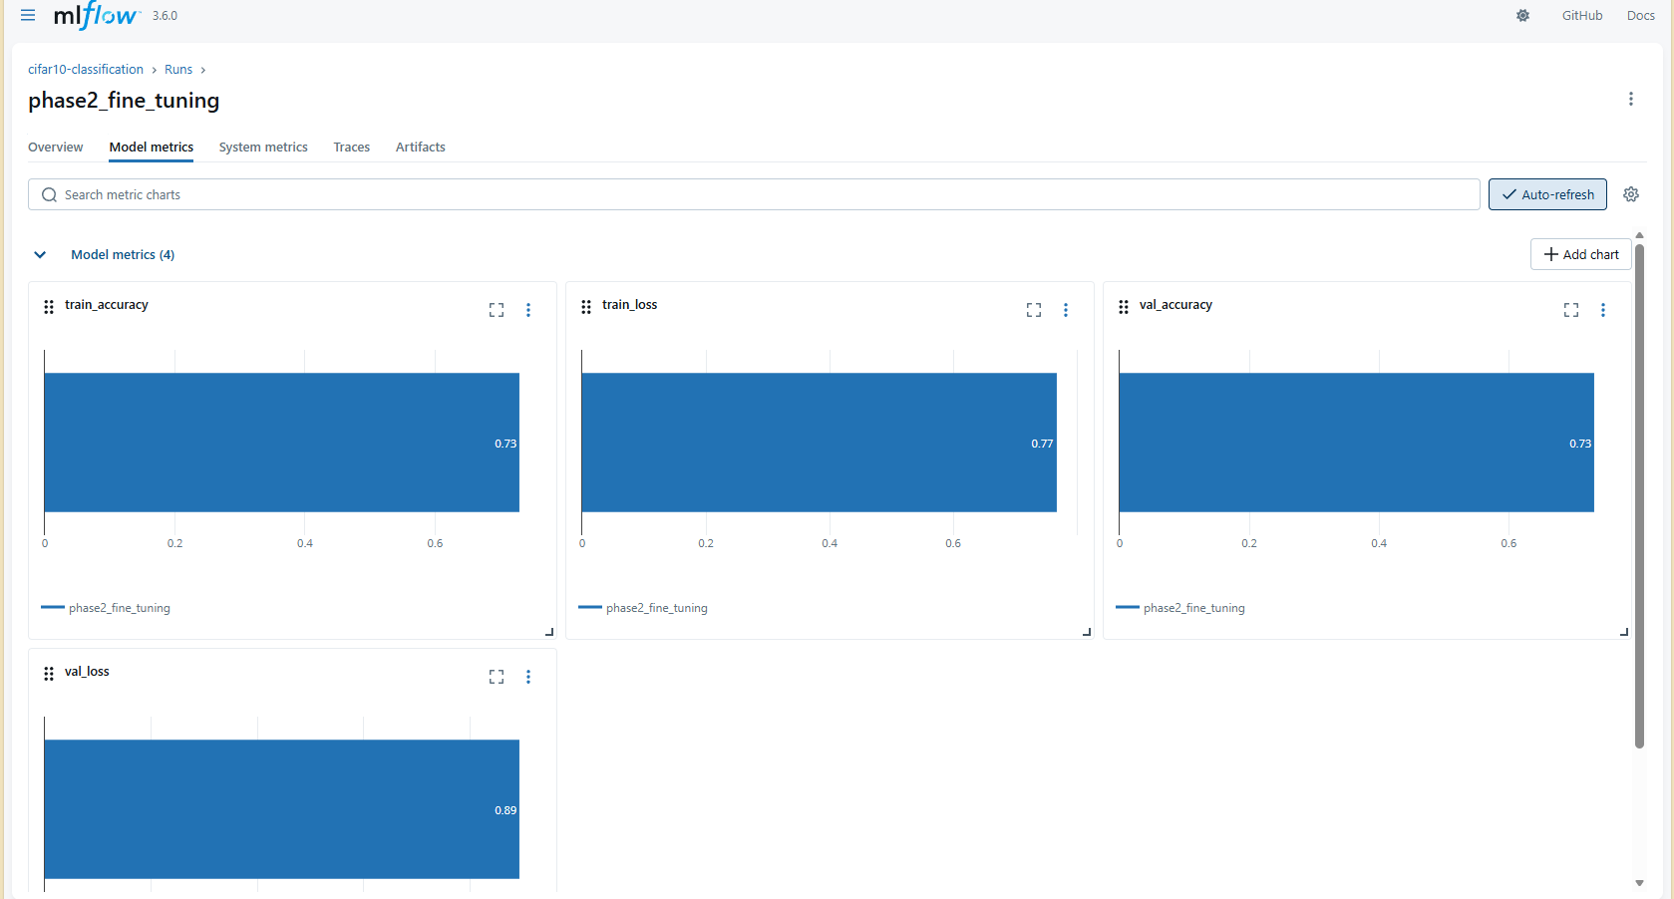

Slide 15
Object Recognition Model

Slide 16
Model Details:
Object Detection system using a pre-trained YOLO model (yolov12x.pt) from the Ultralytics library. The goal was to build a model capable of detecting and classifying multiple objects in images with high accuracy and fast inference speed.
Model Setup and Evaluation
to measure its performance. The evaluation automatically generated detection results and key metrics including:
mAP@0.5 – Measures the overlap quality between predicted and ground-truth bounding boxes.
mAP@0.5:0.95 – A stricter score averaged across 10 IoU thresholds.
Precision – Percentage of predicted boxes that are correct.
Recall – Percentage of actual objects successfully detected.
These metrics provide a full understanding of both accuracy and robustness of the object detection model.

Slide 17
Model Details:
Key Code Operations:
1)Load YOLO model:
model = YOLO("yolov12x.pt")
2) Run validation on COCO128:
metrics = model.val(data="coco128.yaml", imgsz=640)
3) Display sample detection results:
display(Image(filename=img_path))
4) Export structured performance report:
with open("model_evaluation_report.txt", "w") as f:
f.write(report)]
11/28/2025

Slide 18
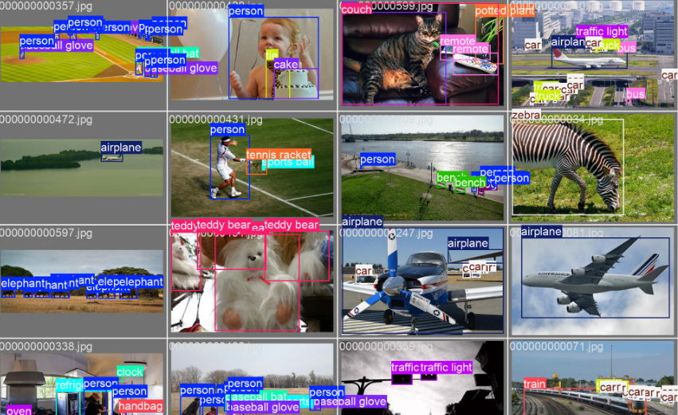
Summary
The YOLOv12x model successfully completed object detection on the validation data, generating reliable performance scores and visual outputs. The evaluation report summarizes the model’s strength in identifying objects with strong precision the project requirements for a trained and evaluated object detection system.
and recall, meeting
11/28/2025

Slide 19

Model Deployment
11/28/2025

Slide 20
Why Deploy?
Make the model accessible to real users
Deliver predictions instantly and at scale
Integrate the system into real workflows
Ensure consistent, reliable performance
11/28/2025

Slide 21
Why Azure?
Reliable cloud infrastructure
Easy model deployment with Azure ML
Scalable compute for heavy workloads
Built-in security and compliance
11/28/2025

Slide 22

Team Members:
List of Team members and tasks worked on.
11/28/2025

Slide 23

Basel Mohamed Mostafa
Worked on:
Image Classification Model.
MLOps & MLFLow.
Project Documentation.
11/28/2025

Slide 24
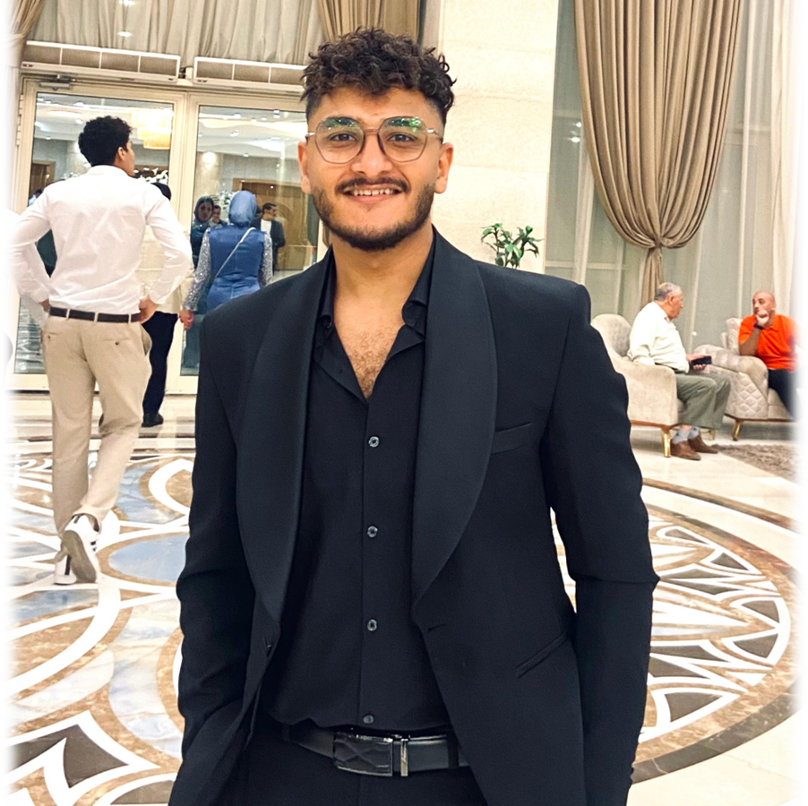
Mohamed Hamada Farghali
Worked on:
Object Detection Model.
11/28/2025

Slide 25
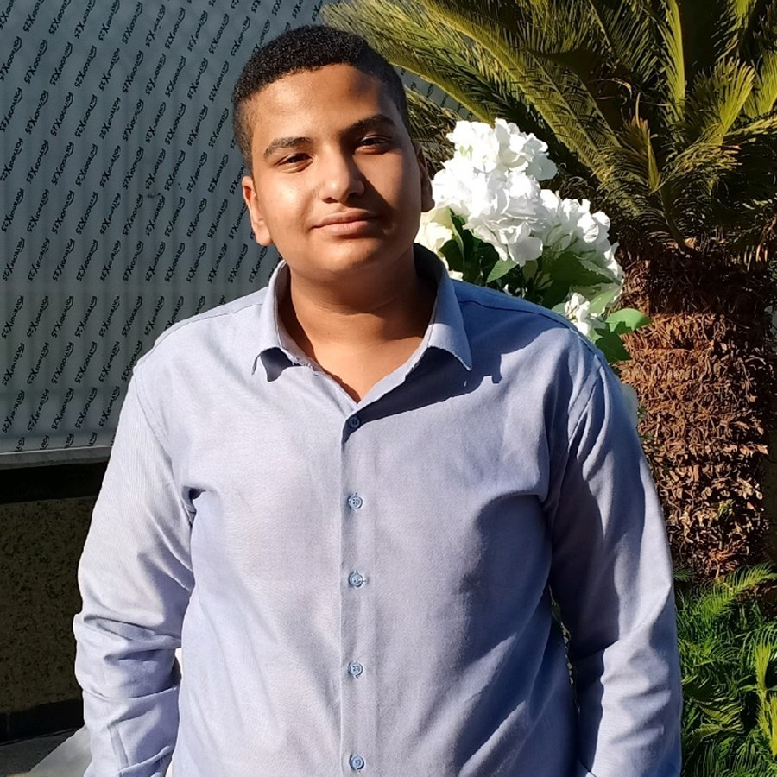
Zeyad Gamal Mohamed
Worked on:
Team Leader
Azure Deployment
11/28/2025

